Slide 1
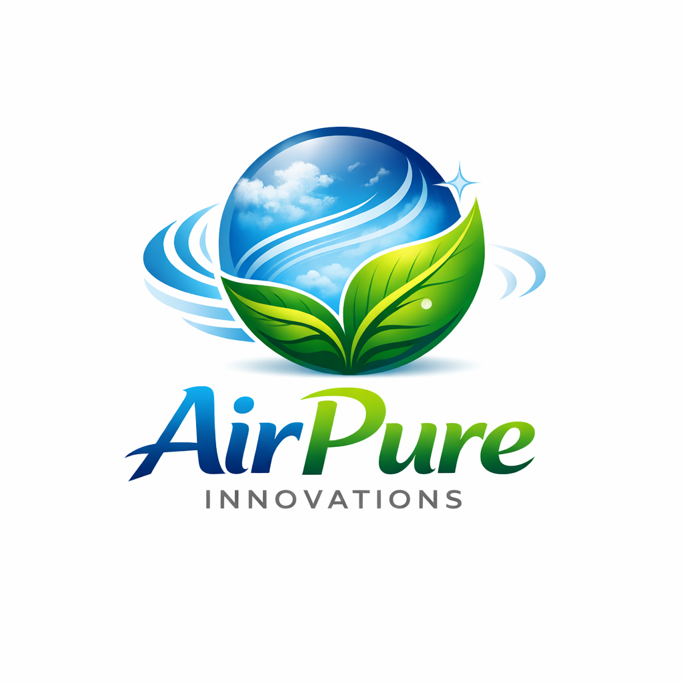
AirPure Innovation Product Market Fit Analysis

Slide 2
Problem Statement
AirPure Innovations is a startup responding to India’s severe air pollution crisis, where 14 cities rank among the world’s top 20 most polluted. As the company prepares to develop its air purifier, it must validate market demand and define the right product strategy before investing in production and R&D.
Key Questions to Address:
Which pollutants should the purifier primarily target?
What essential features are required to stay competitive?
Which cities show the highest demand and market potential?
How can R&D align with localized pollution patterns?

Slide 3
Reports Created
State-Area wise AQI Analysis(2022-2025)
Health Criteria Analysis
EV Vehicle Analysis
Competitor Analysis
Market Analysis

Slide 4
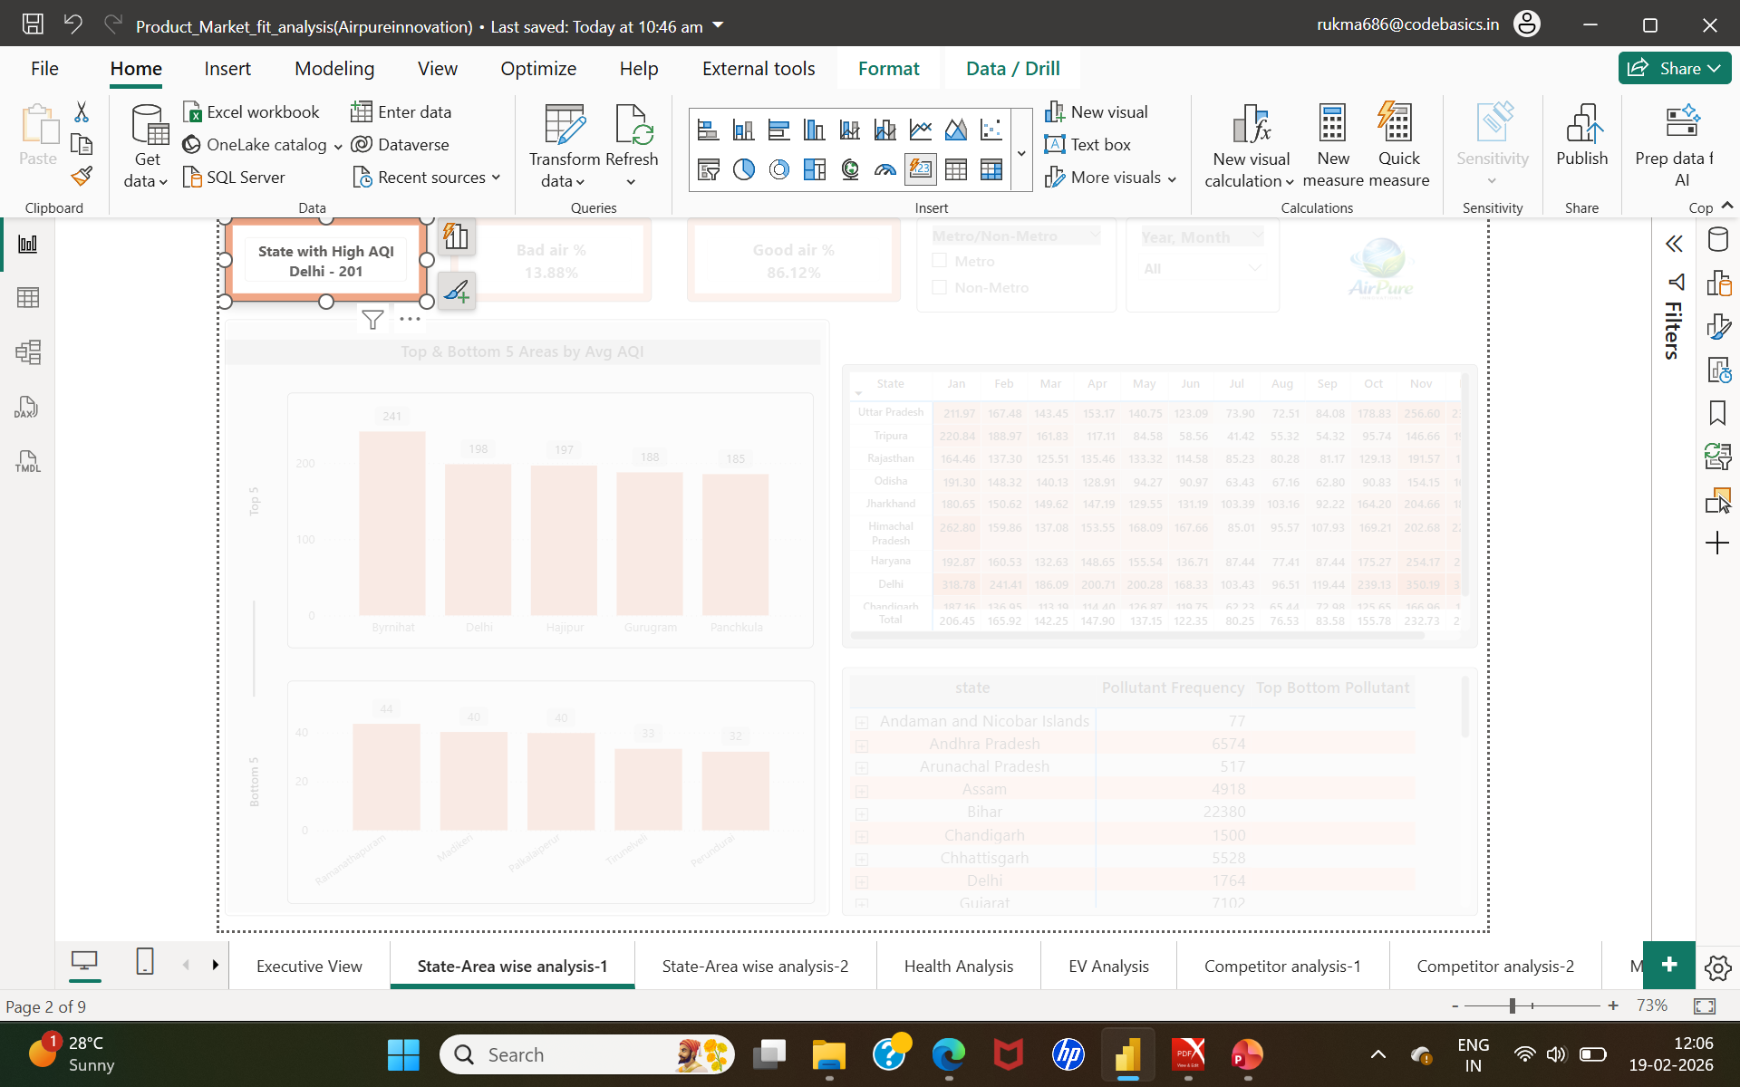
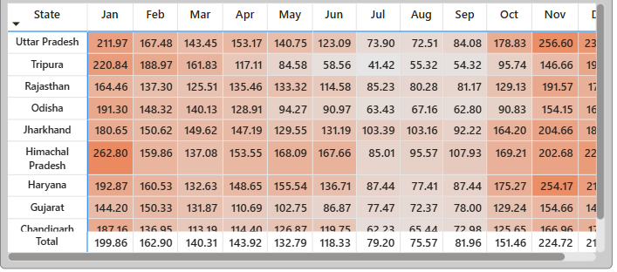
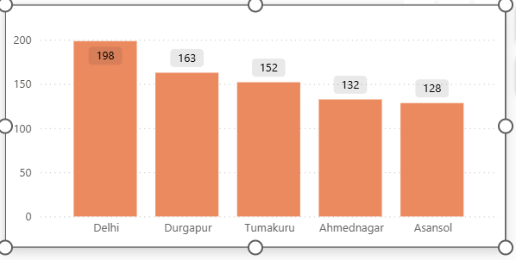
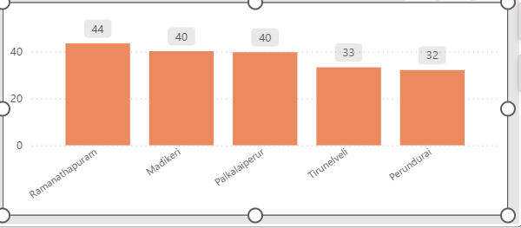
State - Area Wise Analysis
Launch initially in high-AQI cities: Byrnihat, Delhi, Hajipur, Gurugram, Panchkula.
Recognize that pollution severity is high in both metro and non-metro cities.
Focus core filtration technology on PM2.5 and PM10, as they are the most dominant pollutants across regions.
Make HEPA-grade filtration mandatory to ensure strong particulate removal performance.
Highlight high particulate removal efficiency clearly in marketing communication.
Intensify promotions during peak pollution months :- October to January.
Align city targeting, seasonal campaigns, and particulate-focused filtration for strong market entry success.

Slide 5
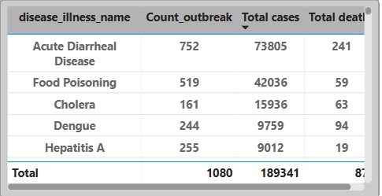
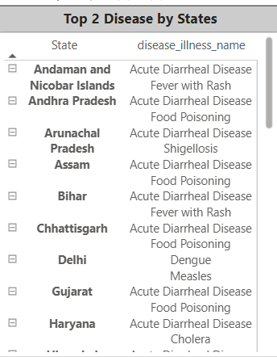
Health Analysis
Air quality levels show no major difference between metro and non-metro cities, with satisfactory and moderate categories dominating.
Key pollutants across regions are PM2.5, PM10, CO, O3, and NO2, requiring strong particulate and gas filtration focus.
High-priority markets include Bengaluru, Hyderabad, Delhi, Mumbai and states like Kerala, Gujarat, Odisha, Madhya Pradesh, Chhattisgarh(Because of the high cases in this region).
Health risk index remains significant in both metro and non-metro regions, with recurring disease burden indicating sustained health vulnerability.
AQI peaks in Quarter 1 from the past three years(2023-2025), making early-year marketing and product positioning critical for demand capture.

Slide 6
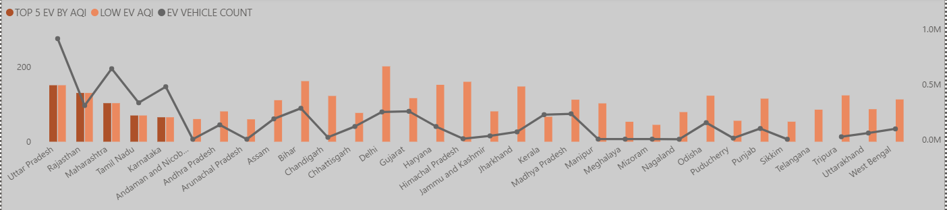
EV Analysis
States with higher EV adoption show lower average AQI (110.53) compared to low-EV states (117.36), indicating a positive environmental impact.
Uttar Pradesh and Maharashtra have both the highest vehicle counts and highest AQI levels, showing a direct vehicle–pollution link.
Petrol vehicles dominate total registrations, while EV count (5 million) is significantly lower than conventional vehicles (73 million).
Even in high-EV states like Rajasthan, Tamil Nadu, and Karnataka,
EV penetration remains too small to significantly reduce AQI.
Strategic recommendation :- Increase EV adoption toward a balanced vehicle mix (target 35–75) in high-AQI states to drive meaningful air quality improvement.

Slide 7
Competitor Analysis
Avg Price | Avg ₹/CADR | Top Pollutants | Dominant Tier
₹22K | ₹55.55 | PM2.5, PM10, VOCs | Mid-Range (66.7%)
Budget (≤ ₹15K)
CADR: 260–450
Coverage: 300–600 sq ft
Filters: H13 HEPA + Carbon
Targets: PM2.5, Dust, Smoke
Smart: Basic modes
Mid-Range (₹15K–₹20K)
CADR: 360–403
Coverage: 360–500 sq ft
Filters: HEPA + Carbon + Antimicrobial
Targets: PM2.5, PM10, VOCs Smart: App + Sensors
Premium (> ₹20K)
CADR: 330–520
Coverage: 538–1000 sq ft
Tech: Plasma / Ion / NanoProtect
Targets: PM2.5, PM10, Formaldehyde, Gases
Smart: App + Voice + Real-time AQI

Slide 8
66.7% of competitors are concentrated in the mid-range segment,
indicating high saturation and intense competition.
Leading brands such as Honeywell, Philips, Xiaomi, Kubo,
and Blueair compete primarily on CADR, coverage, and smart features.
HEPA-based filtration and PM2.5 targeting are now baseline expectations across all price tiers.
Smart features such as app control, real-time AQI display, and voice integration are becoming standard in mid and premium segments.
Clear market gap exists in smart-enabled budget products and strong differentiation in Pollutants targeted and gas/formaldehyde-focused positioning.

Slide 9
Market Analysis
Top recurring pollutants (metro + non-metro): PM2.5, PM10, O₃, NO₂, CO
High AQI (≥100) recorded in - Metro: Delhi, West Bengal, Maharashtra
Non-metro - Bihar, Himachal Pradesh, Haryana, Jharkhand, Tripura
PM2.5 targeted by 13 brands
Viruses targeted by 25 brands
VOCs targeted by 10 brands
PM10 targeted by 4 brands
O₃, NO₂, CO minimally addressed
Clear gap between real pollution profile and brand positioning

Slide 10
Opportunity to dominate gas filtration (O₃, NO₂, CO) segment
Strong positioning if product delivers - 100% focus on PM2.5 & PM10
75% strength on O₃, NO₂, CO.
25–50% coverage on VOCs, bacteria, allergens.
Strategic positioning: Complete urban pollution defense system

Slide 11
Final Recommendation
Pollutant Focus
Strong concentration on PM2.5, PM10, O₃, NO₂, CO
Differentiate by highlighting gas pollutant removal (O₃, NO₂, CO) currently under-addressed
Maintain secondary coverage for VOCs, bacteria, allergens
Price & Performance Positioning
Focus on ₹18,000–₹25,000 mid-range segment (largest competitive cluster)
Target CADR: 450–550
Coverage area: 500–600 sq. ft
Compete directly in performance, outperform in filtration depth
Smart Feature Differentiation
Most competitors already offer: Alexa / Google integration
App control
Real-time AQI
Auto & Sleep mode
Upgrade Strategy
Add AI-driven pollution prediction
City-based AQI alerts
Intelligent filter life optimization
Data-driven purification modes
Geographic Focus Strategy
Target both metro & non-metro high AQI regions
Metro focus: Bengaluru, Mumbai, Delhi
North-East & high-risk non-metro clusters
South Indian pollution-prone cities(Telangana, Andra Pradesh, Coimbatore, Chennai etc)
Market messaging should highlight : City-wise AQI trends.
Local pollutant dominance
Seasonal pollution spikes
Seasonal Marketing Strategy
Heavy advertising push: October – January
Focus on winter AQI surge
Promote as “High Pollution Season Essential”

